Slide 1
Los Angeles COVID and Crime Data Analysis (2021-2022)
Prem Prakash Singh

Slide 2
AGENDA
Introduction
Datasets
Covid Dataset Analysis
Crime Dataset Analysis
Correlation Analysis
Summary

Slide 3
INTRODUCTION
This project aims to analyze and find correlations between COVID-19 data and crime data in Los Angeles for the period of 2020 to 2023. Our goal is to uncover insights into how the pandemic has impacted crime patterns and explore the interplay between public health and social dynamics in LA.

Slide 4
Data Sets

Slide 5
LA County COVID Cases from 2020 to march 2023: COVID cases and deaths for LA County and California State. Updated daily. Data source: Johns Hopkins University (https://coronavirus.jhu.edu/us-map) LA County Crime Data from 2020 to Present: This dataset reflects incidents of crime in the City of Los Angeles dating back to 2020. This data is transcribed from original crime reports that are typed on paper

Slide 6
LA County Crime Data ANALYSIS

Slide 7
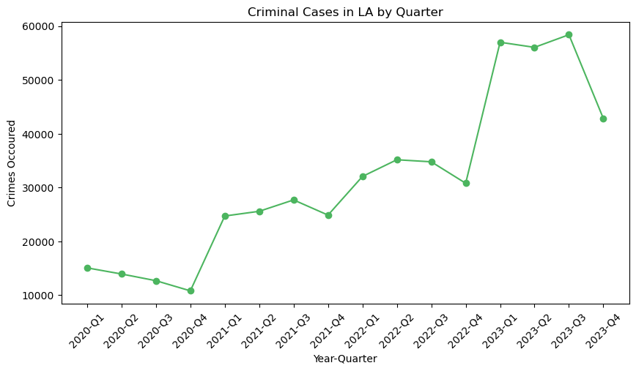
Number of Crimes Occurred by Quarter

Slide 8
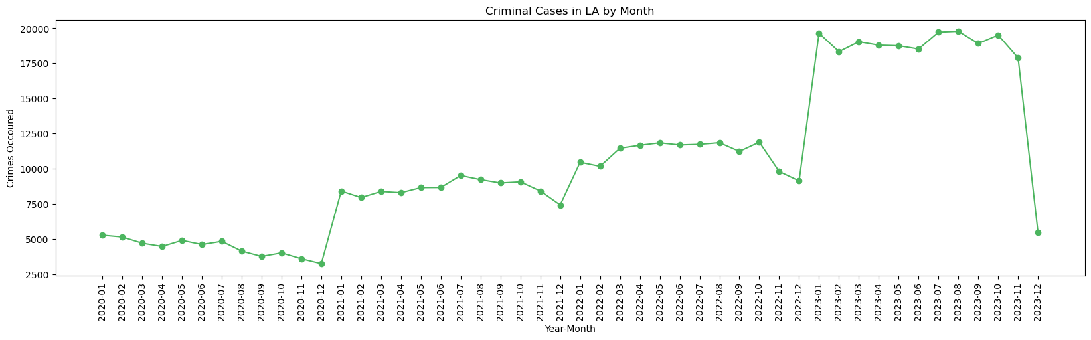
Number of Crimes Occurred by Month

Slide 9
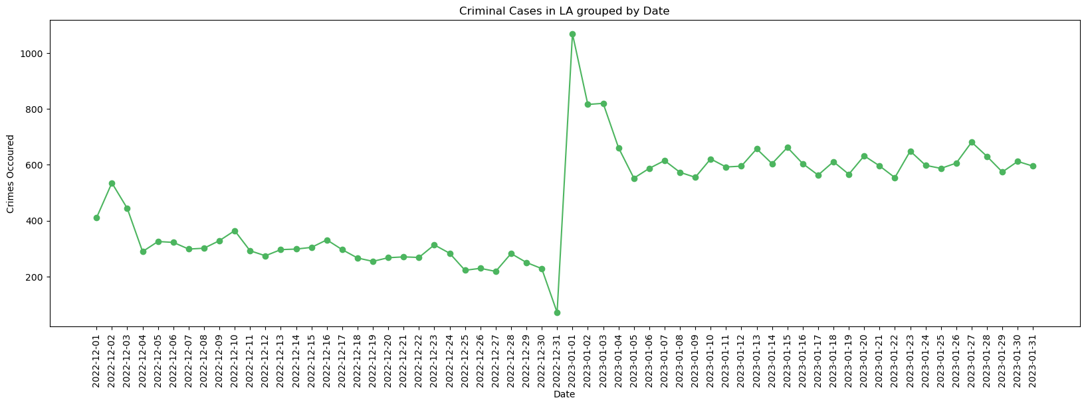
Number of Crimes Occurred During Holiday Season

Slide 10
Increase in Crimes during New Year
* New Year Celebrations
* Increased Crowds
* Fireworks and Firearms
* High Alcohol Consumption
* Tourist Influx
* Stress and Mental Health Issues

Slide 11
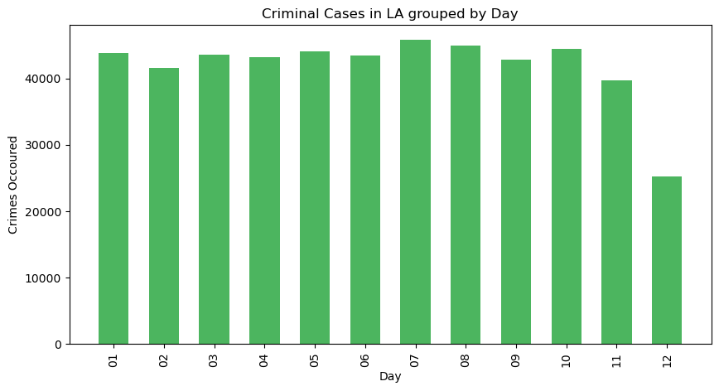
Number of Crimes Occurred By Month

Slide 12
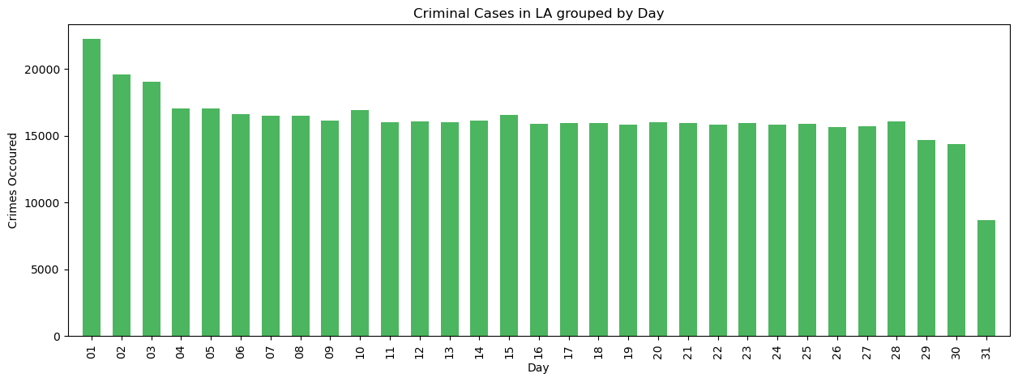
Number of Crimes Occurred During Holiday Season

Slide 13
The observed spike in crime rates around the 31st and 1st of each month in Los Angeles could be attributed to several factors:
1. Paydays and Financial Transactions
2. Rent and Bill Payments
3. Social and Recreational
4. Behavioral Patterns

Slide 14
LA County COVID data analysis

Slide 15
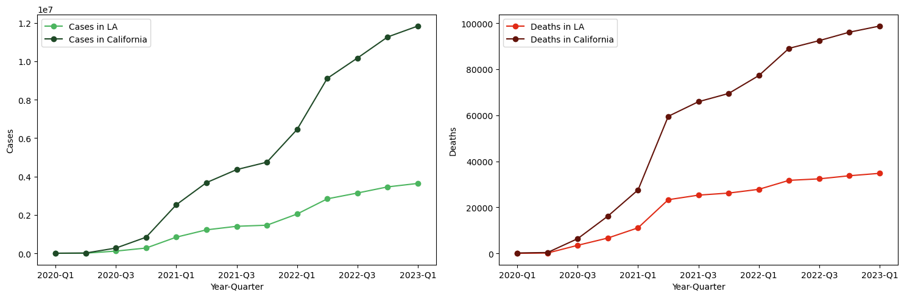
Cumulative Covid cases and deaths by Quarter

Slide 16
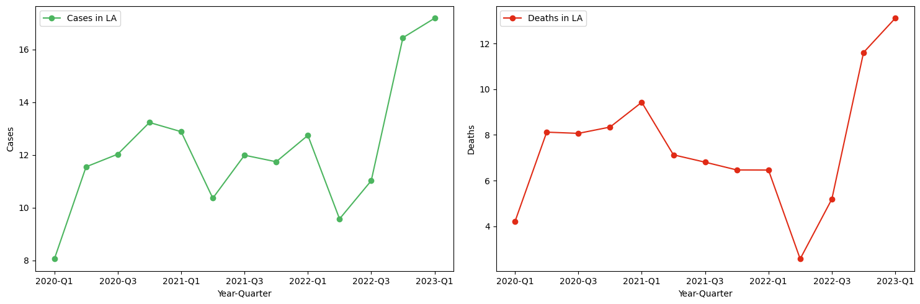
New Covid cases and deaths in LA by Quarter

Slide 17
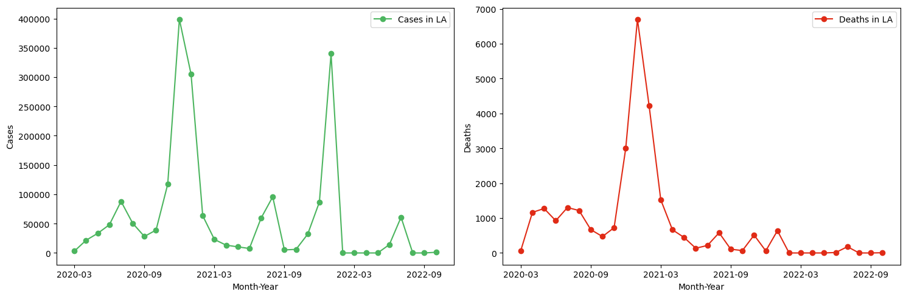
Cumulative Covid cases and deaths by Quarter

Slide 18
The observed spikes in new COVID-19 cases in Los Angeles following May 2020, October 2020, June 2021, November 2021, June 2022, and November 2022 could be linked to a variety of factors:
1. Seasonal Changes and Indoor Gathering
2. Post-Holiday Surges
3. Reopening and Relaxation of Restrictions
4. School Sessions and Vacations
5. Virus Variants and Immunity Waning

Slide 19
The observed spike in New covid cases around the November 2022 and not significant increase in deaths due to covid could be attributed to several factors:
1. Immunity
2. Emergence of Less Severe Variants
3. Improved Treatments and Healthcare Response
4. Demographics of Infected Individuals

Slide 20
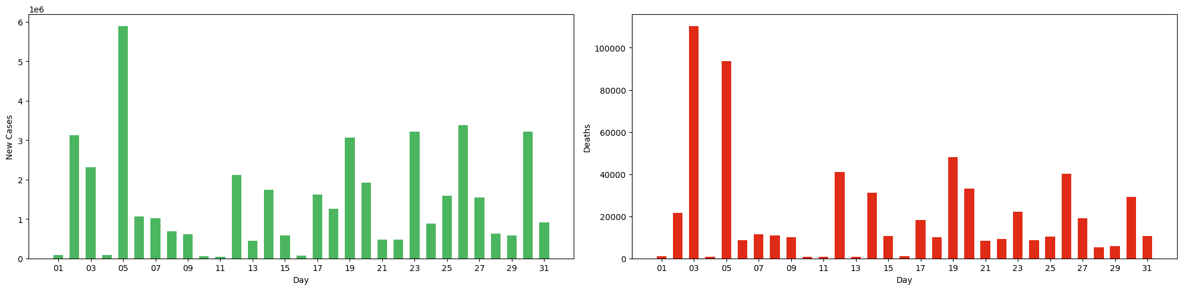
Cumulative Covid cases and deaths by Day

Slide 21
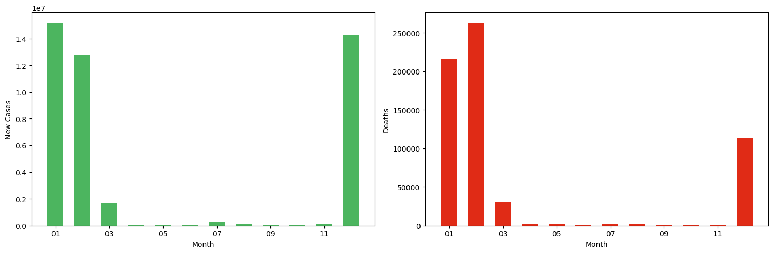
Cumulative Covid cases and deaths by Month

Slide 22
Correlation analysis

Slide 23
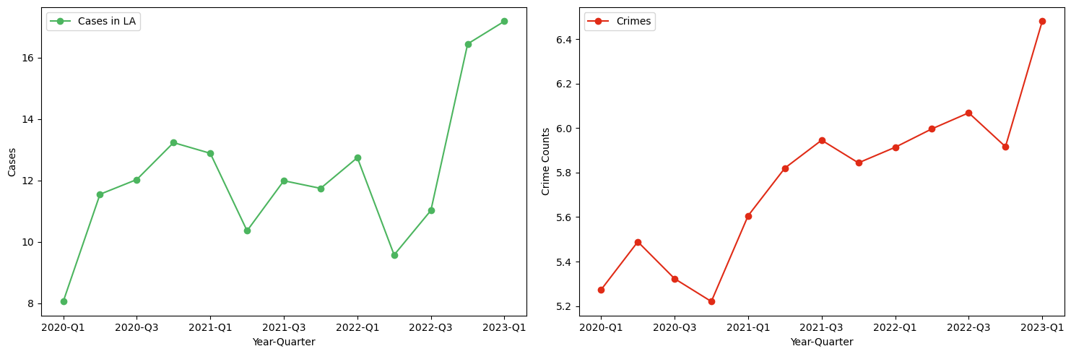
New Covid cases and Number of crimes committed by Quarter
Pearson Correlation coefficient: 0.73
Pearson Correlation coefficient calculated for the data aggregated by Month: 0.51

Slide 24
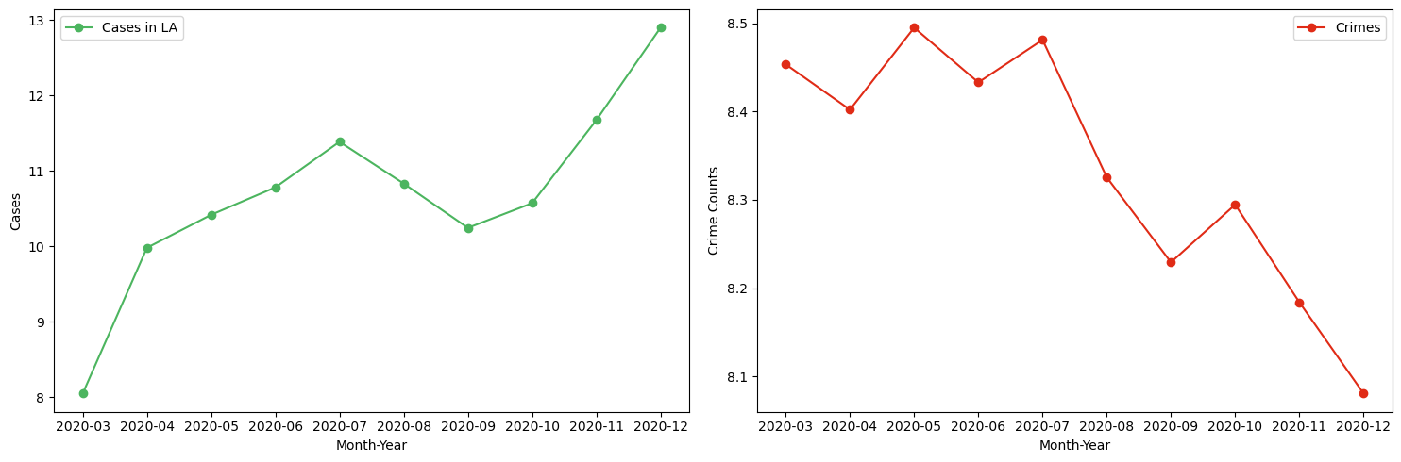
New Covid cases and Number of crimes committed by Quarter
Pearson Correlation coefficient: -0.66

Slide 25
Interpretation
* Preliminary analysis suggests a fluctuating correlation between COVID-19 cases and crimes. However, correlation does not imply causation and varies over time.
* For example, Initially we see from March-2020 to December-2020 there is a negative correlation between new covid cases and number of crimes commited.
Limitations
* The study period may not be sufficient to establish long-term trends.
* External factors influencing crime rates, apart from COVID-19, are not accounted for in this analysis.
correlation does not imply causation

Slide 26
THANK YOU
Prem Prakash Singh
prem.singh@fau.de
https://github.com/PremPrakashS/my-made-repo

